Slide 1
Scrum Training
Hui, Wang
ghostfox911@hotmail.com

Slide 2
Ice Breaking

Slide 3
Why Agile

Slide 4
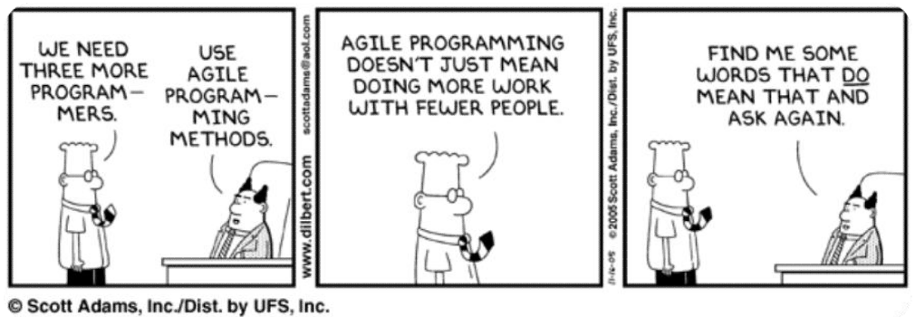
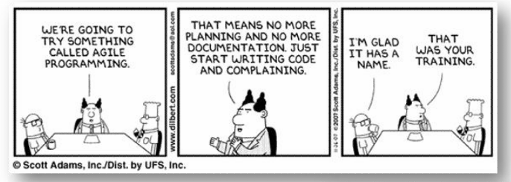
Agile is Popular

Slide 5
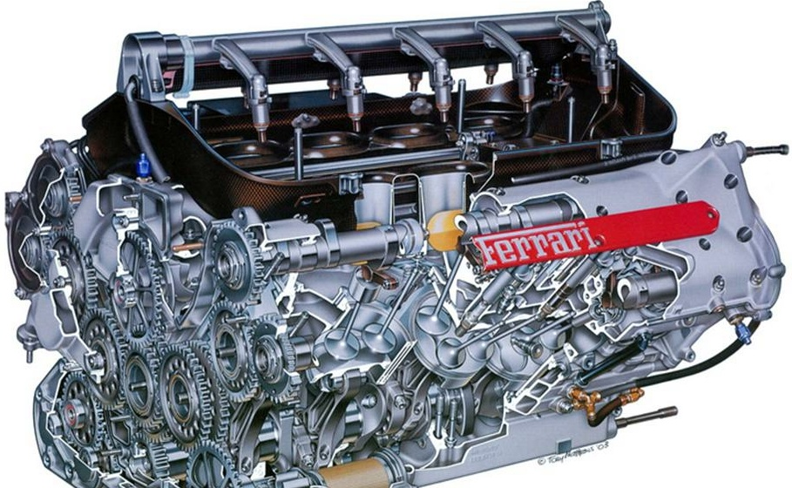
Can you understand Enough in the Beginning ?

Slide 6










Losing Information
1
2
3
4
5
6
7
8
9
10
1. Promise Made by Sales
6. This is Document
2. Requirement Metioned by Customer
7. This is Installation Package
3. Requirement Understood by Project Manager
8. This is Cost
4. Design given by Designer
9. This is Support
5. Coding performed by Programer
10. This is What Really Want by Customer

Slide 7
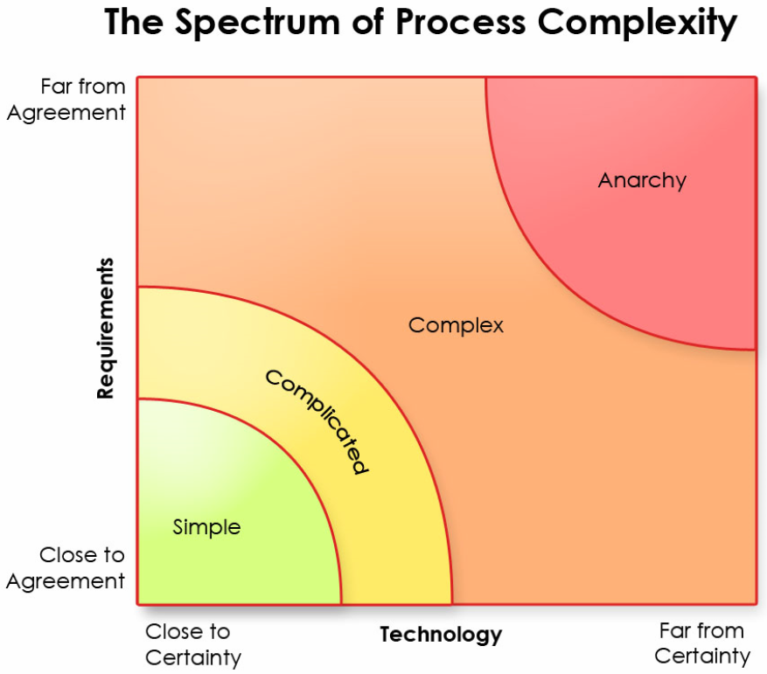
Spectrum of Process Complexity

Slide 8
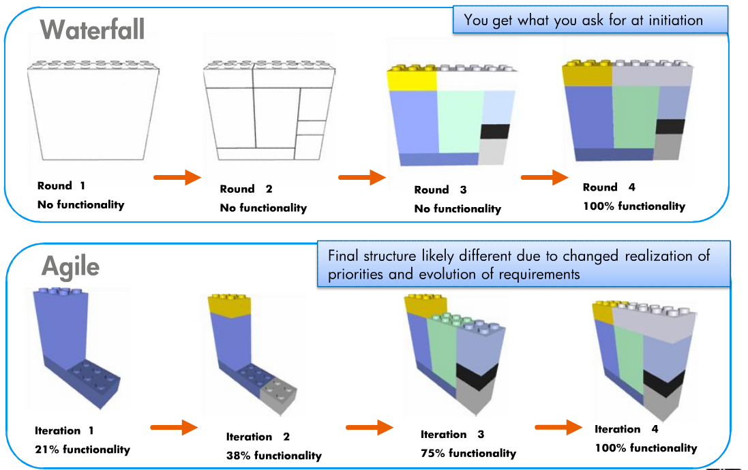
Waterfall VS Agile

Slide 9
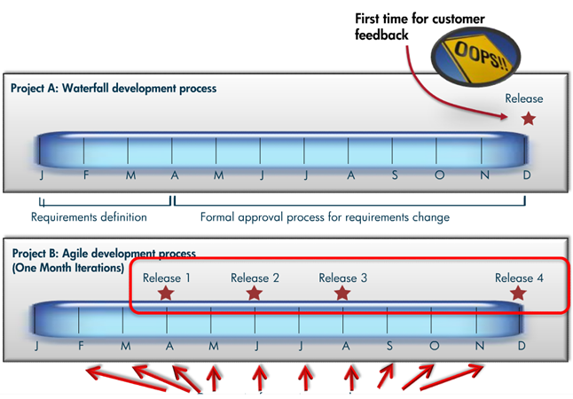
Waterfall VS Agile - Manage Change

Slide 10
Benefits of Agile / 敏捷的优势
Delivers business value early and often
更早更频繁的交付业务价值
Easily adapts to changing requirements and priorities
方便的适应需求变化和优先级调整
Lowers cost of change
降低变更的成本
Provides better visibility into project progress
项目进程的可见性更强
Reduces risk
降低风险
Maximizes ROI
投资回报最大化
Notes:
更快的交付市场
增加生产率
减少成本
方便的适应需求变化和优先级调整
变化的成本更低
项目进程的可见性更强
减少风险
最大化投资回报率
减少浪费
鼓励更高质量和更简单的代码
更早更频繁的交付业务价值
提升团队士气

Slide 11
What is Agile

Slide 12
What is Agile
What is Agile
Agile is about doing the important things first and taking small steps
It’s about people, values, principles, and practices that foster team communication and learning and improving as you go along to regularly deliver customer value through working software
Notes:
Nimble : 灵活
快，轻，方便移动，灵活的特性

Slide 13
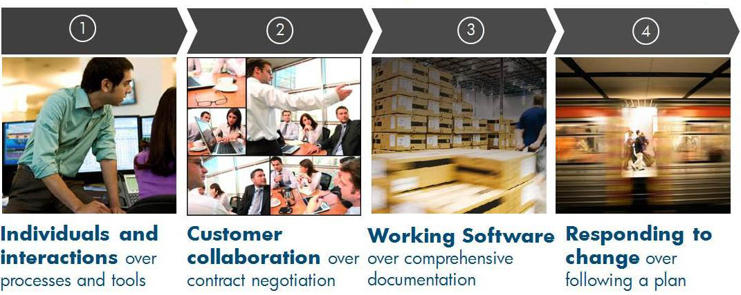
AGILE MANIFESTO

Slide 14
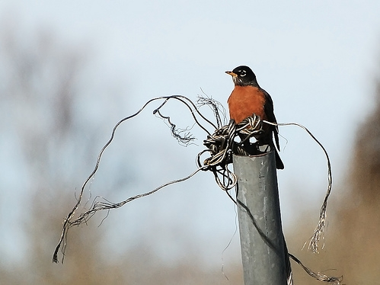

Agile Principles
Agile Principles / 敏捷原则
2. Welcome Change / 欢迎变更
3. Deliver Frequently / 频繁交付
4. Work as a Team / 团队工作
5. Motivate People / 激励成员
6. Communicate Face-to-Face / 面对面沟通
7. Measure Working Software / 衡量可工作的软件
8. Maintain Constant Pace / 保持恒定步骤
9. Excel at Quality / 质量为优
10. Keep it Simple / 保持简单
11. Evolve Designs / 改进设计
12. Reflect Regularly / 定期回顾
1. Satisfy the Customer / 满足客户
Notes:
Our highest priority is to satisfy the customer through early and continuous delivery of valuable software.
Welcome changing requirements, even late in development. Agile processes harness change for the customer's competitive advantage.
Deliver working software frequently, from a couple of weeks to a couple of months, with a preference to the shorter timescale.
Business people and developers must work together daily throughout the project.
Build projects around motivated individuals. Give them the environment and support they need, and trust them to get the job done.
The most efficient and effective method of conveying information to and within a development team is face-to-face conversation.
Working software is the primary measure of progress.
Agile processes promote sustainable development. The sponsors, developers, and users should be able to maintain a constant pace indefinitely.
Continuous attention to technical excellence and good design enhances agility.
Simplicity--the art of maximizing the amount of work not done--is essential.
The best architectures, requirements, and designs emerge from self-organizing teams.
At regular intervals, the team reflects on how to become more effective, then tunes and adjusts its behavior accordingly.

Slide 15


Slide 16
What is Scrum

Slide 17
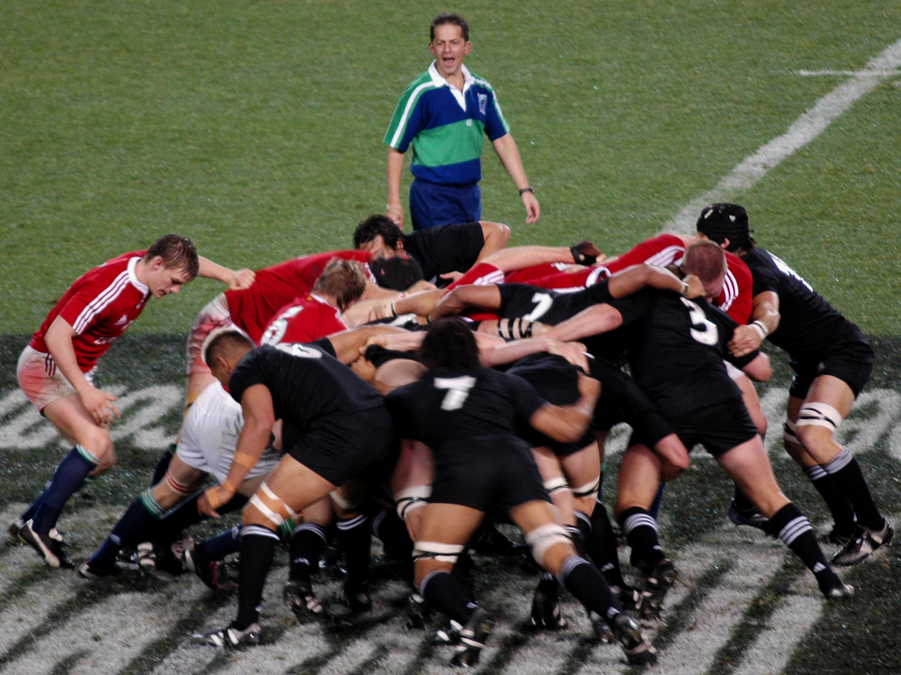
Scrum

Slide 18
SCRUM - 100 words
Scrum is an agile process that allows us to focus on delivering the highest business value in the shortest time
Scrum是一种敏捷流程，允许我们专注于在最短的时间内交付最高的业务价值。
It allows us to rapidly and repeatedly inspect actual working software ( every two weeks to one month).
它允许我们快速、重复的检视实际可工作的软件（每2周至1个月）
The business sets the priorities. Teams self-organize to determine the best way to deliver the highest priority features.
业务决定优先级，团队自我管理、自我决定最好的方式交付最高优先级的功能。
Every two weeks to a month anyone can see real working software and decide to release it as is or continue to enhance it for another sprint.
每2周至1个月，每个人都可以看到真正可工作的软件、并决定发布或持续改进至下一个迭代。
Notes:
Scrum是一个敏捷的过程，他容许我们关注于在最短的时间内交付最高的业务价值
他让我们快速的和可重复的检视时机的可工作软件
业务人员设置优先级，team 自己组织用最好的方法来交付最高优先级的功能
每2周或一个月，每个人都可以看到真正工作的软件。并且决定发布还是在下一个sprint里面继续增强

Slide 19
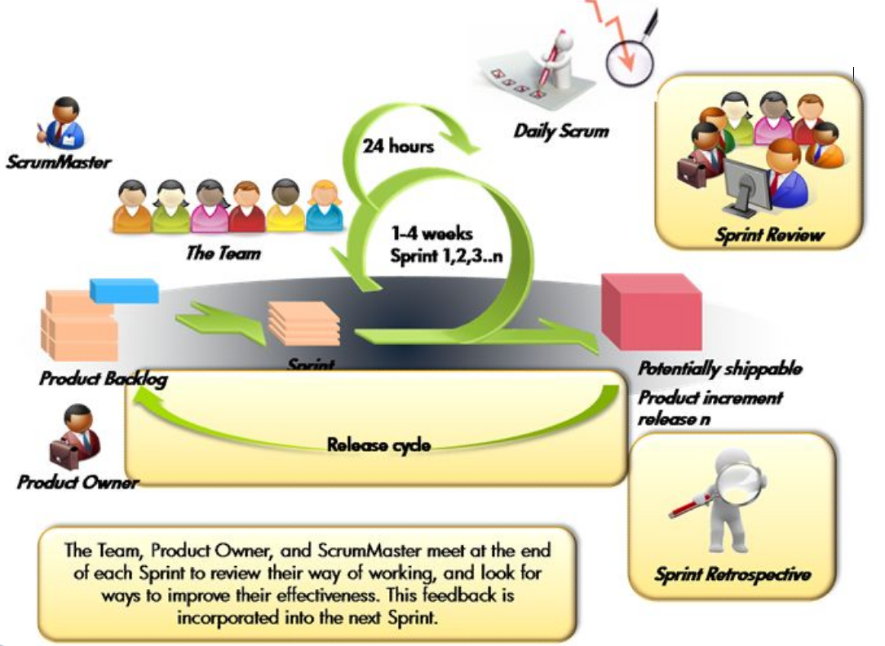
What Scrum look like

Slide 20
Scrum Characteristics
Self-organizing teams
Product progresses in a series of time boxed Sprints
Requirements are captured as items in a list of Product backlog
No specific engineering practices prescribed
Uses generative rules to create an agile environment for delivering projects
One of the Agile processes.

Slide 21
How Scrum

Slide 22

Roles（角色）
Artifacts（产物）
Product owner（产品经理）
ScrumMaster（敏捷教练）
Team（团队）
Product backlog（产品工作列表）
Sprint backlog（迭代工作列表）
Burndown charts（燃尽图）
Ceremonies（仪式）
Sprint planning（迭代计划）
Sprint review（迭代回顾）
Sprint retrospective（迭代总结）
Daily scrum meeting（例会）

Slide 23

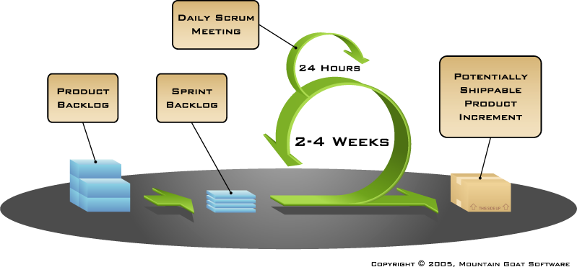






ScrumMaster
Product Owner
Team

Slide 24
Roles
Artifacts
Product owner
ScrumMaster
Team
Product backlog
Sprint backlog
Burndown charts
Ceremonies
Sprint planning
Sprint review
Sprint retrospective
Daily scrum meeting

Slide 25
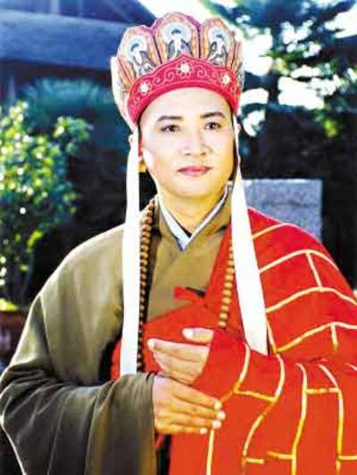
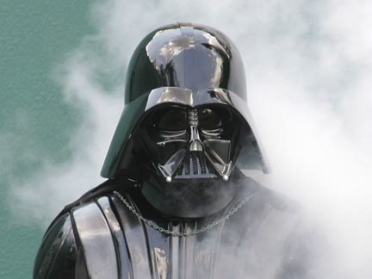
Product owner
Product Owner
What he is
Owner of project vision
Represents the customer
What he can do
Define features
Prioritize features
Pick release dates
Give feedback
Manage stakeholders
Accept or reject results
Define Success
Notes:
项目使命的负责人
代表客户
定义功能
对功能排序
选择发布日期
给与反馈
管理项目相关人
接收或者拒绝结果

Slide 26
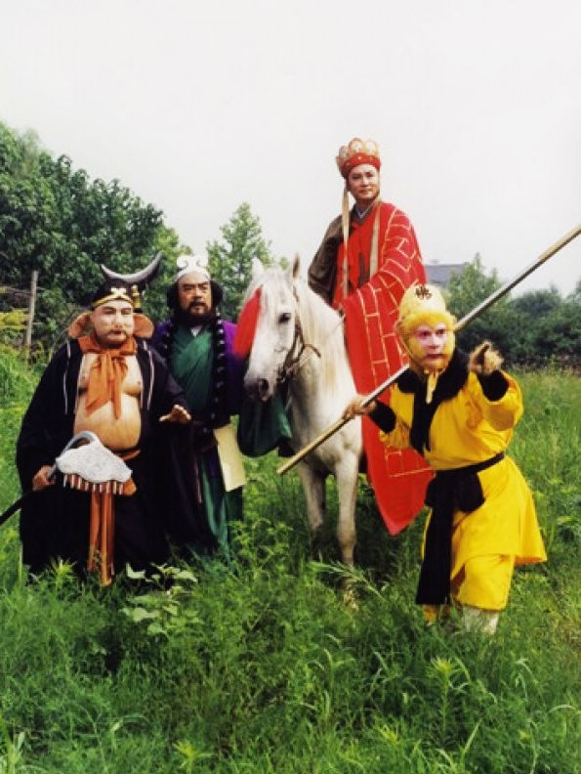
Team
Team
What he is
Typically 5-9 people
Cross functional
Full Time
Self-Organized
What he can do
Define tasks
Estimate effort
Develop product
Ensure quality
Evolve processes
Deliver Success

Slide 27
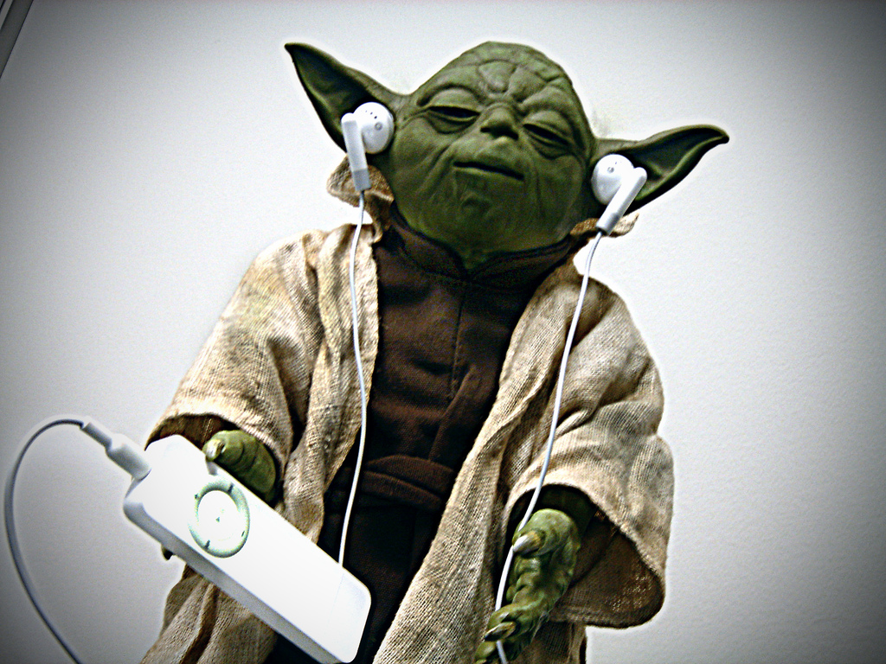

Scrum master
Scrum Master
What he is
Servant leader
Team protector
Troubleshooter
Scrum guide
What he can do
Remove impediments
Prevent interruptions
Facilitate the team
Support the process
Manage management
Ensure Success

Slide 28
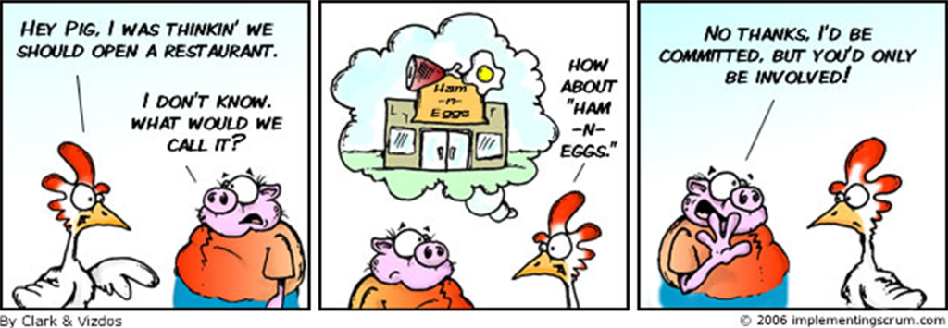
Pigs and Chickens
Product Owner
Scrum Master
Team Members
Users
Managers
Marketing

Slide 29
Roles
Artifacts
Product owner
ScrumMaster
Team
Product backlog
Sprint backlog
Burndown charts
Ceremonies
Sprint planning
Sprint review
Sprint retrospective
Daily scrum meeting

Slide 30

Product BackLog
Product Backlog
The requirements
A list of all desired work on the project
Ideally expressed such that each item has value to the users or customers of the product
Prioritized by the product owner
Reprioritized at the start of each sprint
Ordered
Valued
Estimated
Product Backlog

Slide 31
Product backlog
Product Backlog
Backlog item | Estimate
Allow a guest to make a reservation | 3
As a guest, I want to cancel a reservation. | 5
As a guest, I want to change the dates of a reservation. | 3
As a hotel employee, I can run RevPAR reports (revenue-per-available-room) | 8
Improve exception handling | 8
... | 30
... | 50

Slide 32
Sprint Backlog
Sprint Backlog
Individuals sign up for work of their own choosing
Estimated work remaining is updated daily
Any team member can add, delete or change the sprint backlog
Work for the sprint emerges
If work is unclear, define a sprint backlog item with a larger amount of time and break it down later
Update work remaining as more becomes known
Assignable
Small (1-16hours)
Team Estimated
Sprint Backlog

Slide 33
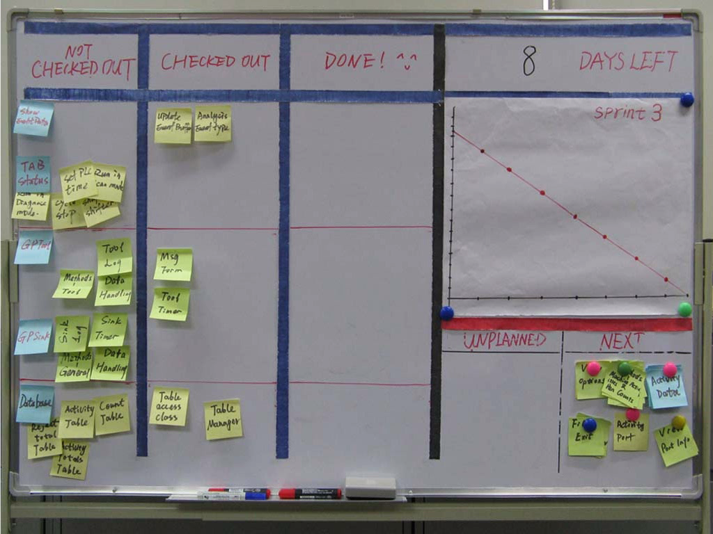
Task Board
Task Board
Visible
Editable
Update Daily
Own By team

Slide 34
Product Backlog VS Sprint Backlog
Product Backlog | Sprint Backlog
Large | Small
More Business | More Technical
Product Owner | Team
User Story | Task
As a vacation planner, I want to see photos of the hotels.
Code the middle tier (8 hours)
Code the user interface (4)
Write test fixtures (4)
Code the foo class (6)
Update performance tests (4)

Slide 35

Burndown chart
Tasks
Mon
Tues
Wed
Thur
Fri
Code user interface
8
4
8
50
Code middle tier
16
12
10
7
Test the middle tier
8
16
16
11
8
40
Write online help
12
30
Hours
20
10
0
Mon
Tue
Wed
Thu
Fri

Slide 36
Roles
Artifacts
Product owner
ScrumMaster
Team
Product backlog
Sprint backlog
Burndown charts
Ceremonies
Sprint planning
Sprint review
Sprint retrospective
Daily scrum meeting

Slide 37





24 hours
Sprint
2-4 weeks
Sprint goal
Return
Sprint backlog
Potentially shippable
product increment
Return
Cancel
Gift wrap
Coupons
Gift wrap
Cancel
Coupons
Product
backlog
Image available at www.mountaingoatsoftware.com/scrum

Slide 38
Sprint
Sprint
Scrum projects make progress in a series of “sprints”
Analogous to Extreme Programming iterations
2 to 4 weeks
A constant duration leads to a better rhythm
Product is designed, coded, and tested during the sprint
Sprint
2-4 weeks

Slide 39
Sprint
Sprint
Change

Slide 40
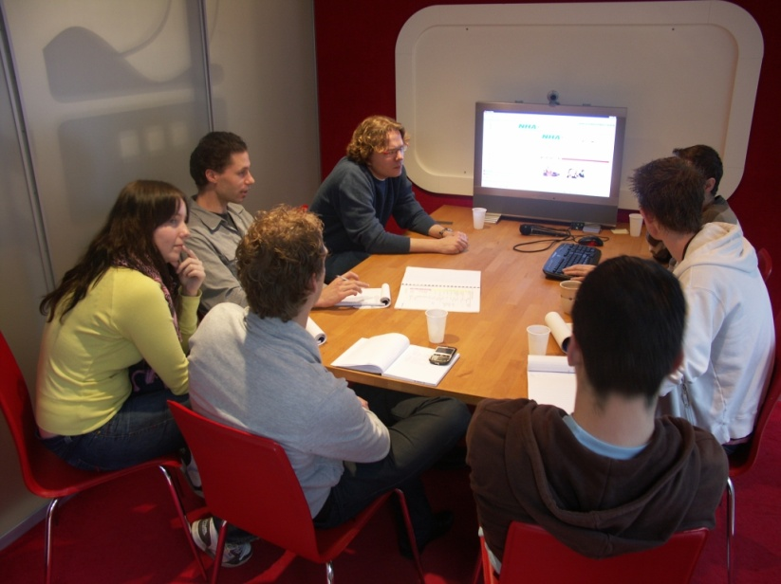
Sprint Planning
Team selects items from the product backlog
Sprint backlog is created
1-16 hours
Collaboratively
High-level design is considered
Sprint backlog

Slide 41



Sprint Planning
Team capacity
Sprint planning meeting
Sprint goal
Sprint prioritization
Product backlog
Analyze and evaluate product backlog
Select sprint goal
Business conditions
Sprint planning
Decide how to achieve sprint goal (design)
Create sprint backlog (tasks) from product backlog items (user stories / features)
Estimate sprint backlog in hours
Current product
Sprint
backlog
Techno-logy

Slide 42
Daily Scrum meeting
Daily Meeting
Daily
15-minutes
Stand-up
Not for problem solving
Whole world is invited
Only “Pig” can talk
Helps avoid other unnecessary meetings

Slide 43
Daily scrum meeting
Daily Meeting
What have you done yesterday?
What will be done today?
Is anything in your way?

Slide 44

Sprint review
Sprint Review
Team presents sprint result
Typically takes the form of a demo
Informal
2-hour prep time rule
No slides
Whole team participates
Invite the world

Slide 45
Sprint retrospective
Sprint Retrospective
Periodically take a look at what is and is not working
Typically 15–30 minutes
Done after every sprint
Whole team participates
Scrum Master
Product owner
Team
Possibly customers and others
What to start doing
What to stop doing
What to continue doing

Slide 46
Roles
Artifacts
Product owner
ScrumMaster
Team
Product backlog
Sprint backlog
Burndown charts
Ceremonies
Sprint planning
Sprint review
Sprint retrospective
Daily scrum meeting

Slide 47
Daily scrum meeting
5 values of Scrum（Scrum的5个价值）
Focus（专注）
Respect（尊重）
Commitment（承诺）
Courage（勇气）
Openess（开放）

Slide 48
Review

Slide 49
Roles
Artifacts
Product owner
ScrumMaster
Team
Product backlog
Sprint backlog
Burndown charts
Ceremonies
Sprint planning
Sprint review
Sprint retrospective
Daily scrum meeting

Slide 50
ScrumMaster
Product Owner
Team

Slide 51
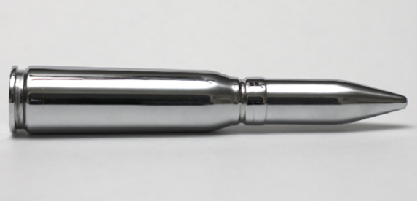
There’s no Silver Bullets

Slide 52
Thank you

